Slide 1
Chapter 1: Introduction

Slide 2
Chapter 1: Introduction
Database System Applications
Purpose of Database Systems
View of Data
Database Languages
Relational Database
Database Design
Data Storage and Querying
Transaction Management
Database Architectures
Database Users and Administrators
History of Database Systems

Slide 3
§1.0 DB, DBMS, DBS, DBMS
Basic Concepts
  Data
  — Values of qualitative（定性) or quantitative(定量) variables, belonging to a set of items (wikipedia)
  — Data as an abstract concept can be viewed as the lowest level of abstraction from which information and then knowledge are derived (wikipedia)
  — Data on its own carries no meaning. For data to become information, it must be interpreted and take on a meaning.

Slide 4

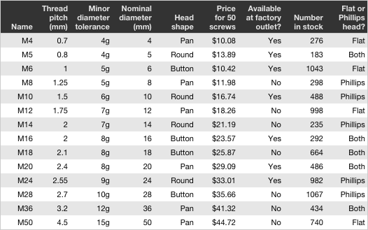
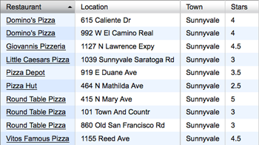
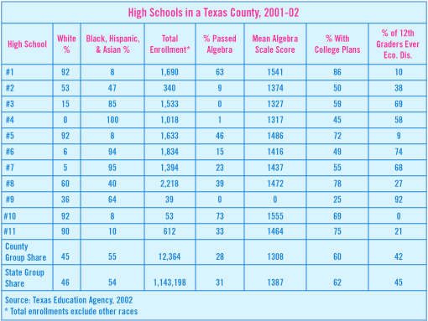
§1.0 DB, DBMS, DBS, DBMS
Database (DB)
  a collection of interrelated data, stored in systems as files
  An integrated collection of related data constitutes a Database(DB)
  related data：the data represents logically coherent facts about some aspects of the real world that are required by an application.
  Integrated：the data for multiple applications is stored together and manipulated in a uniform way on a secondary storage such as a magnetic or an optical disk.

Slide 5
§1.0 DB, DBMS, DBS, DBMS
Database Management System (DBMS)
  a collection of interrelated data and a set of programs to access those data
  An environment that is both convenient and efficient to use
  DBMS is the core of database systems.
  Database systems are designed to manage large bodies of information. Management of data involves both deﬁning structures for storage of information and providing mechanisms for the manipulation of information.

Slide 6
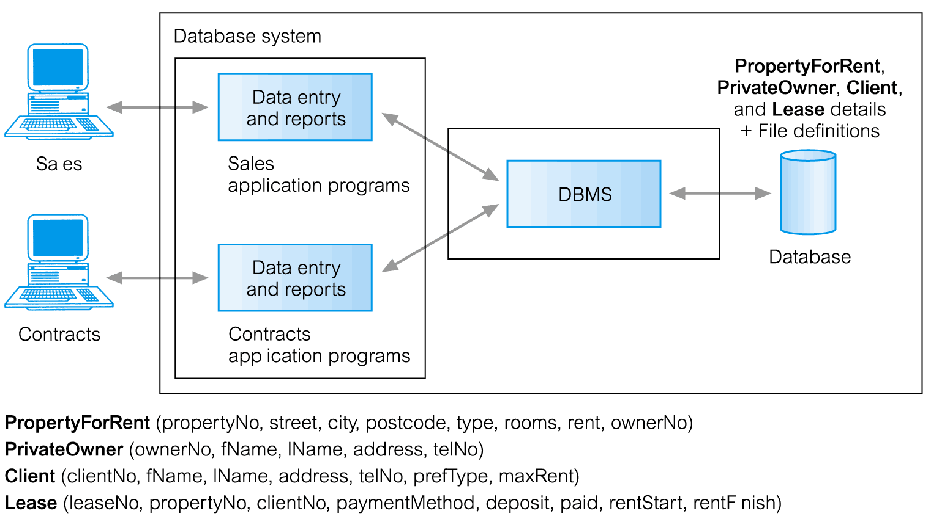
Database Management System (DBMS)

Slide 7

§1.0 DB, DBMS, DBS, DBMS
Database system (DBS)
  having the same definition as DBMS in the textbook
  the term DBS and DBMS are used interchangeably in the textbook
Database system (DBS)
  an application specific database
  the DBMS that maintains that database DBMS
  the application software that manipulates the database 应用程序
DBS

Slide 8
§1.0 DB, DBMS, DBS, DBMS
Definitions in some other textbooks (cont.)
  Database management system (DBMS)
  — a system/mechanism to manage data in DB
  — or: set of programs to access the data in DB
  Database system(DBS)
  — DB + DBMS + Users/Administers
  Database application system
  — DB + DBMS + Application programs + Users/Administers

Slide 9
Database Management System (DBMS)
Database Applications:
  Banking: transactions
  Airlines: reservations, schedules
  Universities: registration, grades
  Sales: customers, products, purchases
  Online retailers: order tracking, customized recommendations
  Manufacturing: production, inventory, orders, supply chain
  Human resources: employee records, salaries, tax deductions
Databases can be very large.
Databases touch all aspects of our lives

Slide 10
Database Management System (DBMS)
E.g.1 12306网站
多用户并发访问， 分布式数据库；
业务突发，负荷非常高；
采用内存数据库技术，提高访问效率
E.g.2 校内各种管理信息系统，如川大教务系统、科研 管理系统
E.g.3 Big Data，
e.g. 百度百科 数据量非常大，无法用常规技术很好地处理；
互联网环境下的海量数据，文本、声音、视频、图形、…等多种类型；
动态、不断地涌现；
分布式组织与存储，分布式处理；
E.g. 4 NONSQL数据库, 按列存储数据

Slide 11
API, e.g.ODBC, JDBC
Application program 1
DB file
Application program 1
DBMS
…
DB query language
e.g. SQL
Users
DBMS
DB
DBS/DBAS
Fig.1.0.1 DBS and DBAS

Slide 12
When Is a Database Management System Needed?
Advantages 1
  Control of data redundancy
  Data consistency
  More information from the same amount of data
  Sharing of data
  Improved data integrity
  Improved security
  Enforcement of standards
  Economy of scale

Slide 13
When Is a Database Management System Needed?
Advantages 2
  Balance of conflicting requirements
  Improved data accessibility and responsiveness
  Increased productivity
  Improved maintenance through data independence
  Increased concurrency
  Improved backup and recovery services

Slide 14
When Is a Database Management System Needed?
Disadvantages
  Complexity
  Size
  Cost of DBMSs
  Additional hardware costs
  Cost of conversion
  Performance
  Higher impact of a failure

Slide 15
When Is a Database Management System Not Needed?
The data has a simple structure and its size is small.
The application, although simple and unchanging, has a special purpose.
Concurrent access to data by multiple users is not required.

Slide 16
1.2 Purpose of Database Systems
University Database Example
Application program examples
  Add new students, instructors, and courses
  Register students for courses, and generate class rosters
  Assign grades to students, compute grade point averages (GPA) and generate transcripts
In the early days, database applications were built directly on top of file systems（ 70年代，数据库实质上是文件系统)
In the case, if new need arises, e.g. new major is to be created, then new files or even new application might be developed to fulfill the requirement.

Slide 17
1.2 Purpose of Database Systems
This typical file-processing system is supported by a conventional operating system
Before database management systems (DBMSs) were introduced, organizations usually stored information in such systems.
It has a number of major disadvantages

Slide 18
1.2 Purpose of Database Systems(cont)
Data management on the basis of file systems
Each program defines and manages its own data.
  Example
  — instuctor_record=<id,name, dept_name, salary> in Instructor_File
  FS access needs
  — file name, item name, length of record, length of item , position of item in the record, storage structure, access method, ….
  Demerit
  — application programs are not independent of the file system ( or operating system)
  — dependency among application programs and data (程序与数据的非独立/依存性）

Slide 19
Recall the methods used in typical file-processing systems
access through
data base system
(DBS)
direct access
through
disk controller
access through
OS’ file system
(III)
(II)
access programs
(III)
(I)
access programs
(II)
DBS API
access programs
(I)
DBMS: relational tables’ logical
structures and access methods
system calls related
to file management
file system:
file’s logical structures and access methods
I/O system : drivers
memory controllers (i.e. disk controller),
on the basis of secondary storage’s physical structures,
such as storage structures, access method
secondary storage (e.g. disk, tape)
and data on it (address: cylinder, track, sector)

Slide 20
DB user
DBMS
DB files
view of
data model
view of file
OS: Logical file
Physical File on disk
Logical
address
: #Record
Physical
address：
platter/track
/sector
DBS
logical
structures:
relations/
tuples
Record₁
…
block1
block₁
Select Name
From Student
Where S#=100
Record_{k}
…
…
block
block_{i}
Record_{i}
…
Block n
…
Record_{m}
block_{k}
OS：file system and I/O subsystem
Fig. 1.0.3 Database access

Slide 21
File System vs. DBMS: Data Storage
File System:
class Customer {
Integer cid;
String name;
String city;
Float rebate;
boolean checkRebate() {…}
}
class Book { … }
Data definitions repeated in each
program…
DataBase System:
CREATE TABLE Customer (
cid INTEGER CHECK (cid>0),
name VARCHAR(20),
city VARCHAR(20),
rebate FLOAT
);
CREATE TABLE Book ( … );
Data definitions once in the central data
dictionary of a DBMS.
=> Same for all applications
Central idea:
Database keeps metadata
about its
content and state

Slide 22
File System vs. DBMS: Data Access
File System:
VAR o : order;
p : product;
fh1, fh2: file_handle;
fh1 = Open(
order_file
);
WHILE NOT EOF(fh1) DO
o := getnext(fh1);
IF o.month = 10 AND o.day >= 19 THEN
fh2 = Open(
product_file
);
WHILE NOT eof(fh2) DO
p := getnext(fh2);
IF p.pnr=o.pnr AND p.stock<100 THEN
WriteCard(o.pnr, o.quantity);
END;
END;
close(fh2):
END;
END; close(fh1);
You have to program it by hand,
over and over and over …
Database System:
SELECT pnr, quantity
FROM Orders o JOIN Products p
WHERE o.month = 10 AND o.day >= 18
AND p.stock < 100
Declarative queries
- easy to read and maintain
- evtl. usable from different applications
- efficient evaluation due to
automatic optimization

Slide 23
Drawbacks of using file systems to store data
  Data redundancy and inconsistency(数据冗余和不一致)
    Multiple file formats, duplication of information in different files(同一数据的不同副本不一致)
  Difficulty in accessing data(数据访问困难)
    Need to write a new program to carry out each new task
  Data isolation — multiple files and formats(数据孤立）
  Integrity problems（完整性问题）
    Integrity constraints (e.g., account balance > 0) become “buried” in program code rather than being stated explicitly
    Hard to add new constraints or change existing ones

Slide 24
Drawbacks of using file systems to store data (Cont.)
  Atomicity of updates（原子性问题）
    Failures may leave database in an inconsistent state with partial updates carried out
    Example: Transfer of funds from one account to another should either complete or not happen at all
  Concurrent access by multiple users（并发访问）
    Concurrent access needed for performance
    Uncontrolled concurrent accesses can lead to inconsistencies
      Example: Two people reading a balance (say 100) and updating it by withdrawing money (say 50 each) at the same time
  Security problems（安全性）
    Hard to provide user access to some, but not all, data
    Database systems offer solutions to all the above problems

Slide 25
Database Approach
Arose because:
  Definition of data was embedded in application programs, rather than being stored separately and independently.
  No control over access and manipulation of data beyond that imposed by application programs.
Result:
  the database and Database Management System (DBMS).

Slide 26
Levels of Abstraction
Physical level: describes how a record (e.g., customer) is stored.
(物理层描述如何保存（磁介质等)
Logical level: describes data stored in database, and the relationships among the data.
  type instructor = record
  ID : string;
  name : string;
  dept_name : string;
View level: application programs hide details of data types. Views can also hide information (such as an employee’s salary) for security purposes.

Slide 27
§1.3 View of Data
A major purpose of a database system is to provide users with an abstract view（抽象视图） of the data.
That is, the system hides certain details of how the data are stored（存储） and maintained（维护）
Most drawbacks of typical file-processing systems are due to the dependency among application programs and data （程序与数据的非独立/依存性）.
On the contrary, DBMS is proposed to allow users to access and modify data more easily and more efficient.
How can DBMS make it works?
–Key: Data abstraction

Slide 28
§1.3 View of Data
For the system to be usable, it must retrieve data efﬁciently.
The need for efﬁciency has led designers to use complex data structures to represent data in the database.
Since many database-system users are not computer trained, developers hide the complexity from users through several levels of abstraction, to simplify users’ interactions with the system

Slide 29
§1.3 View of Data
Basic concepts in DBS theory
  view of data (数据视图), data abstract
  data model, data schema (模式), schema instance
  logical /physical isolation
1.3.1 Data abstraction
Data View
  data features from some viewpoints
  e.g. about student, his name, sex, age, ….
To simplify and “divide and conquer” the design of complex data application systems
  describes/design application data in three levels, and obtains three types of schema

Slide 30

§1.3 View of Data
瞎子摸到的大象，局部性质
An architecture for a database system
V-L映射，逻辑独立性
百科全书中的大象
森林中的大象
L-P映射 物理独立性

Slide 31
1.3.1 Data abstraction (cont.)
View level(External Level）
  The users’ view of the database -- The view of the ‘real world’ represented in a form that is familiar for users. 用户眼中的数据库 局部 逻辑
  describe data from
    how the data items in DB are used by different users
  several views for one datum
  description results
    external schema（外模式）={view}, set of views
  description procedure/Logical DB design
    view abstraction
  merits: application programs are programmed according to views. Views can also hide information (e.g., salary) for security purposes.

Slide 32
1.3.1 Data abstraction (cont.)
E.g. Banking Application Areas
  from more than one viewpoints, view integration
  view1: customer<id, name, street, city>
  view2: customer <borrower, loan>
  view3: customer <depositor, account>
  view4: loan<loan-number, amount>
  view5: account<account-number, balance>
  view6: ….

Slide 33
1.3.1 Data abstraction (cont.)
Logical level（ Conceptual Level)
  implementation-oriented, describes how the data items are stored in DBS (e.g. as relational tables), and what relationships exist among those data : (全局，逻辑）
table customer
name : string;
street : string;
city : integer;
  description results
    logical schema (逻辑模式）, e.g. relational tables
  description procedure/Logical DB design
    logical abstraction
  Merits: hiding physical implementation details

Slide 34
1.3.1 Data abstraction (cont.)
Logical level（ Conceptual Level)
Consists of a conceptual schema of DB (What should be stored?) (由一个数据库概念模式构成, 包含整个数据库应存储的数据. 解决应该存储哪些数据的问题).
contains logical representation of the entire DB, which includes (包含整个数据库的逻辑表示, 包括):
  all entities, their attributes, and their relationships;
  constraints on data;
  security & integrity info.
supports each user view, in which any data must be contained in, or derived from, the conceptual schema (支持每个用户视图, 其中的任何数据都必须源自概念模式).

Slide 35
1.3.1 Data abstraction (cont.)
Physical level（Internal Level）
  describes how the data (e.g., customer record/table) are actually stored in files ( or in secondary storage, e.g. disk)
  description results
    physical/internal schema (物理模式，内模式）
    i.e. storage structure and access methods, such as index, physical blocks, access methods for secondary memory, etc.
  description procedure/Physical DB design
    physical abstraction

Slide 36
Data Independence
Logical Data Independence
  Refers to immunity of external schemas to changes in conceptual schema.
  Conceptual schema changes (e.g. addition/removal of entities).
  Should not require changes to external schema or rewrites of application programs.

Slide 37
1.3.1 Data abstraction (cont.)
外模式／模式映像
  定义外模式与模式之间的对应关系
  每一个外模式都对应一个外模式／模式映像
  映像定义通常包含在各自外模式的描述中
外模式／模式映象的用途
  保证数据的逻辑独立性
  当模式改变时，数据库管理员修改有关的外模式／模式映象，使外模式保持不变
  应用程序是依据数据的外模式编写的，从而应用程序不必修改，保证了数据与程序的逻辑独立性，简称数据的逻辑独立性。

Slide 38
Data Independence
Physical Data Independence
  Refers to immunity of conceptual schema to changes in the internal schema.
  Internal schema changes (e.g. using different file organizations, storage structures/devices).
  Should not require change to conceptual or external schemas.

Slide 39
1.3.1 Data abstraction (cont.)
模式／内模式映像
  定义了数据全局逻辑结构与存储结构之间的对应关系。例如，说明逻辑记录和字段在内部是如何表示的
  数据库中模式／内模式映象是唯一的
  该映象定义通常包含在模式描述中
模式／内模式映象的用途
  保证数据的物理独立性
  当数据库的存储结构改变了（例如选用了另一种存储结构），数据库管理员修改模式／内模式映象，使模式保持不变
  应用程序不受影响。保证了数据与程序的物理独立性，简称数据的物理独立性程序不必修改，保证了数据与程序的逻辑独立性，简称数据的逻辑独立性。

Slide 40


View 2
Conceptual model
internal model
现实
世界
abstract
转换
abstract
View 1
Figure three data models

Slide 41
ANSI/SPARC Architecture
成绩单
学号：xxxxx | 姓名：xxx | 性别：x
离散数据 |  | 75
数据库系统 |  | 81
…… |  | ……
External/Conceptual mapping
Sno | Sname | Ssex | Sage | Sdept
Cno | Cname | Cpno | Ccredit
………………
…………………
Sno | Cno | Grade
……
Conceptual/Internal mapping
MAPPING

Slide 42
ANSI/SPARC Architecture
用三层体系结构的目的：用户的数据库视图和数据库物理描述分离——〉数据独立性，较低层改变不影响较高层
  All users should be able to access same data(用户访问的数据相同，视图不同，且互相不影响)
  A user’s view is immune to changes made in other views. Users should not need to know physical database storage details.用户不处理物理存储的细节
  DBA should be able to change database storage structures without affecting the users’views. 修改数据存储结构，不影响视图
  Internal structure of database should be unaffected by changes to physical aspects of storage. 存储结构变化不影响数据库内部结构。
  DBA should be able to change conceptual structure of database without affecting all users.修改概念结构不影响用户

Slide 43
1.3.2 Instances and Schemas
Similar to types and variables in programming languages
Schema – the logical structure of the database
  Example: The database consists of information about a set of customers and accounts and the relationship between them
  Analogous to type information of a variable in a program
  Physical schema: database design at the physical level
  Logical schema: database design at the logical level
  Subschema (子模式): database design at the view leve

Slide 44
1.3.2 Instances and Schemas
Instance – the actual content of the database at a particular point in time
  the content of the database at a particular point in time
  实例 ：按模式组织的一个具体的数据
  E.g . 2017级学生档案信息
Schema and Instance
E.g.
  schema : customer=<c_name, c_id, street, city>
  instance of schema : <Tom, 1001, Manhatton , New York >

Slide 45
1.3.3 Data Models 数据模型 ,
Purpose: To represent data in an understandable way.
Data descriptions/abstractions in three levels must obey three types of specification, i.e. three types of data models（三种类型数据模型）
A collection of tools for describing 一个软工具集合
  data 数据
  data relationships 数据之间的联系
  data semantics 数据语义
  data constraints 数据约束
A data model provides a way to describe the design of a database at the physical, logical, and view levels.

Slide 46
1.3.3 Data Models
In the course, data models can be classified as
Conceptual Data Model（概念模型）
  Entity-Relationship Model (实体-联系模型
  Data constraints
Logical Data Model（逻辑模型）
  Relational model (关系模型)
  network data model (网状模型)
  hierarchical data model (层次模型)
  Object-based data model (基于对象的数据模型)
  Semistructured data model (半结构化数据模型)
Physical Data Model（物理模型）
  B* tree model…

Slide 47
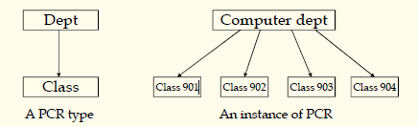
1.3.3 Hierarchical Data Model
Basic idea: because many things in real world are organized in hierarchy, hierarchical model manages
Parent-Child relationship (PCR): the most basic data
Relationship in hierarchical model. It expresses a 1:N
relationship between two record types

Slide 48
1.3.3 Network Data Model
The basic data structure is “set”, it represent a 1:N relationship between things in real world. “1” side is called owner, and “N” side is called member. One record type can be the owner of multi sets, and also can be the member of multi sets. Many sets form a network structure to express real world.
It breakthrough the limit of hierarchical structure, so can express non-hierarchical data more easy.
Record and data items: data items are similar as field in hierarchical model, but it can be vector.
Set : express the 1:N relationship between two record types.
LINK record type: used to express self relationship,
M:N relationship and N-ary relationship.

Slide 49
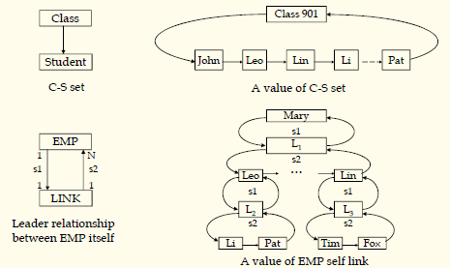
1.3.3 Network Data Model

Slide 50
Relational Model
The basic data structure is “table”, or relation. The things and the relationships between them in real world are all expressed as tables, so it can be researched in strict mathematic methods. It raises the database technology to a theory height. Its features:
Based on set theory, high abstract level
Shield all lower details, simple and clear, easy to understand
Can establish new algebra system——relational algebra
✓ Non procedure query language——SQL
✓

Slide 51

Relational Model
Relational model (Chapter 2)
Example of tabular data in the relational model
Columns
Rows

Slide 52
A Sample Relational Database

Slide 53
§1.4 Database Language
Database Languages as (user-machine) interfaces
  data manipulation language, DML
  data definition language, DDL
1.4.1 Data manipulation language
DML is the language that enables users to access or manipulate the data as organized by the appropriate data model
Types of DBS access
  retrieve , insert, delete, modify

Slide 54
1.4.1Data Manipulation Language (DML)
Language for accessing and manipulating the data organized by the appropriate data model
  DML also known as query language
Two classes of languages
  Procedural – user specifies what data is required and how to get those data
  Declarative (nonprocedural) – user specifies what data is required without specifying how to get those data
SQL is the most widely used query language

Slide 55
1.4.1 Data Manipulation Language (DML)
SQL is the most widely used non-procedural query language, others are QE, Datalog
Example
  find the name of the customer with customer-id 192-83-7465
  select customer.customer-name
  from customer
  where customer.customer-id = ‘192-83-7465’

Slide 56
1.4.2 Data Definition Language (DDL)
Specification notation for defining the database schema
  Example: create table instructor (
  ID char(5),
  name varchar(20),
  dept_name varchar(20),
  salary numeric(8,2))
DDL compiler generates a set of table templates stored in a data dictionary
Data dictionary contains metadata (i.e., data about data)
  Database schema
  Integrity constraints
    Primary key (ID uniquely identifies instructors)
    Referential integrity (references constraint in SQL)
      e.g. dept_name value in any instructor tuple must appear in department relation
  Authorization
DDL例子
模式，字段长度 名称类型
存储结构存取方法

Slide 57
SQL
SQL: widely used non-procedural language
  Example: Find the name of the instructor with ID 22222
  select name
  from instructor
  where instructor.ID = ‘22222’
  Example: Find the ID and building of instructors in the Physics dept.
  select instructor.ID, department.building
  from instructor, department
  where instructor.dept_name = department.dept_name and
  department.dept_name = ‘Physics’
Application programs generally access databases through one of
  Language extensions to allow embedded SQL
  Application program interface (e.g., ODBC/JDBC) which allow SQL queries to be sent to a database
Chapters 3, 4 and 5

Slide 58
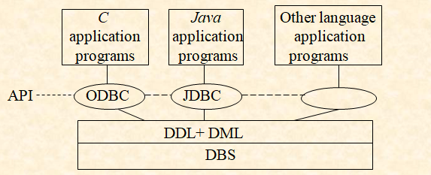
DB Access for Application Programs
Application programs generally access databases in two methods
  application program interfaces (API, e.g. ODBC, JDBC, ADO, …), which allow SQL queries to be sent to a database
  embed DML call within host language (宿主语言, such as C and Java)

Slide 59
1.6 Database Design
The process of designing the general structure of the database:
Logical Design – Deciding on the database schema. Database design requires that we find a “good” collection of relation schemas.
  Business decision – What attributes should we record in the database?
  Computer Science decision – What relation schemas should we have and how should the attributes be distributed among the various relation schemas?
Physical Design – Deciding on the physical layout of the database

Slide 60
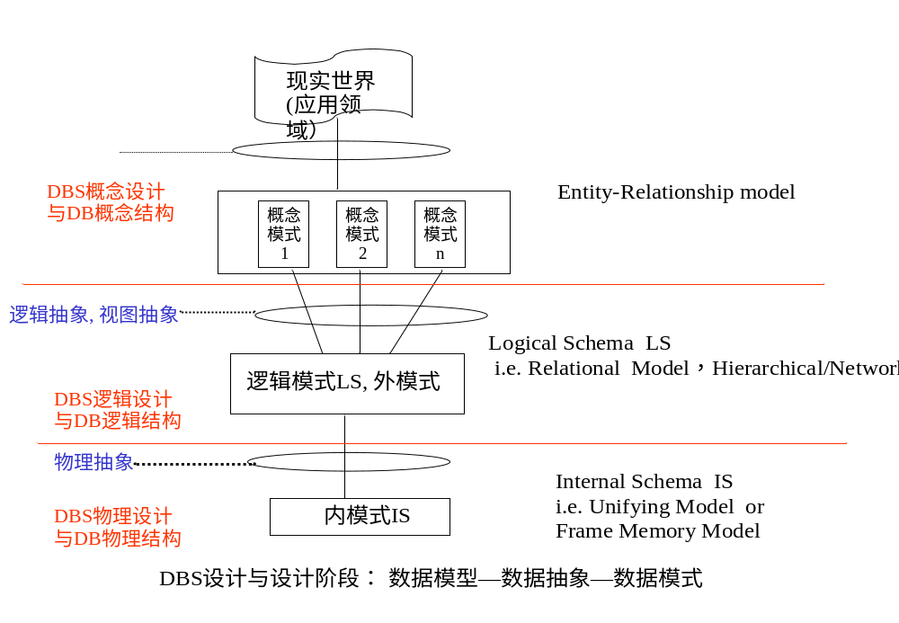
Fig. 1.0.6 Data abstraction and Schema

Slide 61

§1.6 Database Design?
Is there any problem with this design?

Slide 62
Design Approaches
Normalization Theory (Chapter 8)
  Formalize what designs are bad, and test for them
Entity Relationship Model (Chapter 7)
  Models an enterprise as a collection of entities and relationships
    Entity: a “thing” or “object” in the enterprise that is distinguishable from other objects
      Described by a set of attributes
    Relationship: an association among several entities
  Represented diagrammatically by an entity-relationship diagram:

Slide 63

The Entity-Relationship Model
Models an enterprise as a collection of entities and relationships
  Entity: a “thing” or “object” in the enterprise that is distinguishable from other objects
    Described by a set of attributes
  Relationship: an association among several entities
Represented diagrammatically by an entity-relationship diagram:
What happened to dept_name of instructor and student?

Slide 64
§1.7 Data Storage and Querying
In DBS, DBMS provides data management mechanisms for users, that is, data storage and data querying
DBMS consists of two modules
  storage manager
  query processor
Storage manager is a program module that provides the interface between the low-level data stored in the database and the application programs and queries submitted to the system
The storage manager is responsible for
  translating DML statements into low-level file commands
  efficient storing, retrieving and updating of data

Slide 65
§ 1.7 Data Storage and Querying (cont.)
The modules in the storage manager are
  authorization and integrity manager, transaction manager, file manager, and buffer manager
The query processor includes
  DDL interpreter
  DML compiler
  Query optimization
  Query evaluation engine

Slide 66
C, Pascal programs
SQL query
程 序 编 译 / 编译器
词法/语法/语义分析
查询处理 / DBMS
扫描和语法/语义分析
中间代码生成
关系代数表达式&查询树
Chapter13, 14
(中间)代码优化
查询优化
(§14)
(优化后)查询执行计划
目标代码生成
查询代码生成
(§13)
目标程序代码
查询计划执行的代码
事务、存储处理 / DBMS
process / thread
transaction
程序执行 /
进程管理
&进程调度
并发控制
死锁处理
事务管理
&事务调度
并发控制
恢复技术
Chapter
15,16, 17
死锁处理
OS
(§15)
(§16)
(§17)

Slide 67
§1.8 Transaction Management
A transaction is a collection of operations that performs a single logical function in a database application
E.g. Transaction T1: transfer $50 from account_A to account_B
  T1 : read ( account_A );
account_A := account_A -50;
write (account_A );
read (account_ B );
account_ B := account_ B + 50;
write (account_ B );
  integrity constraint
  total amount of account_A and account_B remains unchanged before and after the transaction execution

Slide 68
§1.8 Transaction Management
Transaction properties
  atomicity (原子性), consistency (一致性), isolation (独立性), durability(持久性)
Transaction-management component in DBMS
  ensures that the database remains in a consistent/correct state despite system failures (e.g., power failures and operating system crashes) and transaction failures, by means of concurrency and control failure recovery.
  controls the interaction among the concurrent transactions, to ensure the consistency of the database

Slide 69

user
DBMS
DB
Fig. 1.6
DBS Architecture

Slide 70
Storage Management
Storage manager is a program module that provides the interface between the low-level data stored in the database and the application programs and queries submitted to the system.
The storage manager is responsible to the following tasks:
  Interaction with the file manager
  Efficient storing, retrieving and updating of data
Issues:
  Storage access
  File organization
  Indexing and hashing

Slide 71
§1.9 DBS Architecture
DBS = User/DBA + DBMS + DB
DBMS
  query processing
  storage manager
DB files
  application data
  data dictionary/directory
  indices
  statistic data

Slide 72

Query Processing
1. Parsing and translation
2. Optimization
3. Evaluation

Slide 73
Query Processing (Cont.)
Alternative ways of evaluating a given query
  Equivalent expressions
  Different algorithms for each operation
Cost difference between a good and a bad way of evaluating a query can be enormous
Need to estimate the cost of operations
  Depends critically on statistical information about relations which the database must maintain
  Need to estimate statistics for intermediate results to compute cost of complex expressions

Slide 74
Transaction Management
What if the system fails?
What if more than one user is concurrently updating the same data?
A transaction is a collection of operations that performs a single logical function in a database application
Transaction-management component ensures that the database remains in a consistent (correct) state despite system failures (e.g., power failures and operating system crashes) and transaction failures.
Concurrency-control manager controls the interaction among the concurrent transactions, to ensure the consistency of the database.

Slide 75
1.10 Data Mining and Information Retrieval
Data Mining
  Analyze large databases to find knowledge(useful rules and patterns)
  Example: young women with annual incomes greater than $50,000 are most likely people to buy small sports cars.
Information Retrieval
  Querying of unstructured textual data
  Emphasis: querying based on keywords, the relevance of documents to the query, classification and indexing of documents;

Slide 76
1.11 Specialty Databases
Object-Relational Data Models
Relational model: flat, “atomic” values
Object Relational Data Models
  Extend the relational data model by including object orientation and constructs to deal with added data types.
  Allow attributes of tuples to have complex types, including non-atomic values such as nested relations.
  Preserve relational foundations, in particular the declarative access to data, while extending modeling power.
  Provide upward compatibility with existing relational languages.

Slide 77
1.11 Specialty Databases
XML: Extensible Markup Language
Defined by the WWW Consortium (W3C)
Originally intended as a document markup language not a database language
The ability to specify new tags, and to create nested tag structures made XML a great way to exchange data, not just documents
XML has become the basis for all new generation data interchange formats.
A wide variety of tools is available for parsing, browsing and querying XML documents/data

Slide 78
1.11 Specialty Databases
Other Specialty Databases
  Time-squential Database（时序数据库)
  Active Database(ADB)(主动数据库）
  Spatial Database (空间数据库）
  Real Time Database(RTDB)(实时数据库）
  Main Memory Database(MMDB)(内存数据库）
  Engineering Database(工程数据库）
  MultiMedia Database（MDB)(多媒体数据库）

Slide 79

1.12 Database Users and Administrators
Database

Slide 80
Database Users and Administrators
Users are differentiated by the way they expect to interact with the system 用户类型
Application programmers – interact with system through DML calls 程序员
Sophisticated users – form requests in a database query language 复杂用户，高级用户
Specialized users – write specialized database applications that do not fit into the traditional data processing framework 特殊用户
Naïve users – invoke one of the permanent application programs that have been written previously 朴素用户
  E.g. people accessing database over the web, bank tellers, clerical staff

Slide 81
Database Administrators
Coordinates all the activities of the database system; the database administrator has a good understanding of the enterprise’s information resources and needs. 最高权力
Database administrator‘s duties include: 权力与任务
  Schema definition 定义模式，存储结构，取方法
  Storage structure and access method definition
  Schema and physical organization modification
  Granting user authority to access the database
  Specifying integrity constraints 给定完整性
  Acting as liaison with users 普通用户
  Monitoring performance and responding to changes in requirements 监视性能
  八字 ：模储取物，权整用监

Slide 82

Database System Internals

Slide 83

Application Architectures 应用体系
中间件
等求而应有求必应
Two-tier architecture: E.g. client programs using ODBC/JDBC to
communicate with a database 两层结构
Three-tier architecture: E.g. web-based applications, and
applications built using “middleware” 三层结构
<number>/65

Slide 84
Database Architecture
The architecture of a database systems is greatly influenced by
the underlying computer system on which the database is running:
Centralized
Client-server
Parallel (multi-processor)
Distributed

Slide 85
1.13 History of Database Systems
1950s and early 1960s:
  Data processing using magnetic tapes for storage
    Tapes provided only sequential access
  Punched cards for input
Late 1960s and 1970s:
  Hard disks allowed direct access to data
  Network and hierarchical data models in widespread use
  Ted Codd defines the relational data model
    Would win the ACM Turing Award for this work
    IBM Research begins System R prototype
    UC Berkeley begins Ingres prototype
  High-performance (for the era) transaction processing

Slide 86
History (cont.)
1980s:
  Research relational prototypes evolve into commercial systems
    SQL becomes industrial standard
  Parallel and distributed database systems
  Object-oriented database systems
1990s:
  Large decision support and data-mining applications
  Large multi-terabyte data warehouses
  Emergence of Web commerce
Early 2000s:
  XML and XQuery standards
  Automated database administration
Later 2000s:
  Giant data storage systems
    Google BigTable, Yahoo PNuts, Amazon, ..

Slide 87
Appendix A
Data, Information, Knowledge
1.0.1 Definitions in Microsoft Press Computer Dictionary
data
  Plural of datum , an item of information
Information:
  the meaning of the data as it is intended to be interpret by people
  data consist of facts, which become information as they are seen in context and convey meaning to people. Computer process data without any understanding of what the data represents

Slide 88
Appendix A
Data, Information, Knowledge (cont.)
1.0.2 Definitions in Longman Dictionary of Contemporary English
data
  facts, information
  information in a form that can be processed and stored in computers
Information
  knowledge in the form of facts and news

Slide 89
Appendix A
Data, Information, Knowledge (cont.)
knowledge
  what a person knows;
  the facts, information, skills and understanding that one has gained, esp. through learning or experience
1.0.3 Definitions in Cambridge International Dictionary of English
Data
  information, esp. facts or numbers , collected for examination and used to help decision—making
  or, information in a electronic form that can be processed by computers

Slide 90
Appendix A
Data, Information, Knowledge (cont.)
Information
  knowledge about something , esp. facts and news
Knowledge
  information, esp. facts or numbers , collected for examination and used to help decision—making
  understanding of ,or information about a subject which has been obtained by experience or study, and which is either in a person’s mind or possessed by people generally

Slide 91
Appendix B
Category of Data Model
Data models can be classified as
  object-based data model(基于对象的数据模型)
  record-based data model(基于记录的数据模型)
  physical data model(物理数据模型)
基于对象（Object-based）的数据模型
  用处： DBS概念设计阶段，在概念和视图级别上描述数据，定义DBS概念/外模式，生成概念DBS
  包括：实体—联系模型、面向对象（object-oriented）数据模型
    面向对象模型: 对象、对象类; 类 = 变量/属性 + 方法

Slide 92
Appendix B
Category of Data Model (cont.)
基于记录的数据模型
  用处：DBS逻辑设计阶段，生成数据库逻辑模式。与DBMS相关，决定了不同的DBS类型。
  包括：关系数据模型、层次型数据模型、网状数据模
物理数据模型
  用处： DBS物理设计阶段，定义DBS的DBS文件的物理存储结构和存取方法，生成物理数据库模式。与DBMS和DBS的实现相关。
  包括：Unifying Model、Frame Memory Model

Slide 93
End of Chapter 1

Slide 94
Review
Basic Concepts:
  Data, Database, DBMS
  Purpose of DBMS: Solve the problem of
    Data redundancy and inconsistency
    (数据冗余和不一致)
    Difficulty in accessing data
    Data isolation (数据孤立)
    Integrity problems (完整性问题)
    Atomicity of updates (更新操作的原子性)
    Concurrent access by multiple users
    (多用户并发访问)
    Security problems (安全性问题)

Slide 95
Review
View of Data
  Data Abstraction
    architecture for a database system
      Physical level
      Logical level
      View level
  Schema
    Physical schema
    Logical schema
    Subschema
  Instance
  Physical Data Independence
SSDUT-Software School of DUT

Slide 96
Review
View of data
  Data Model
    a collection of conceptual tools
  Classification of Data Model
    Conceptual Data Model
    Logical Data Model
    Physical Data Model
Database Languages
  DDL & DML
  SQL
Relational database
  based on the relational model

Slide 97

Figure 1.02

Slide 98
Figure 1.04

Slide 99

Figure 1.06

